Slide 1
Running ARTIQ experiments in the QPAL Network Lab
P. Huft, April 2024
Last update: 2024.06.15

Slide 2
Last update
Recent updates to this manual included:
Node-specific config files for device aliases and AOM feedback channels
Visualizing measurement status with progress_bar applet
Visualizing DDS RF powers with plot_xy_multichannel
GeneralVariableScan feature to override ExperimentVariables
AOM feedback with AOMPowerStabilizer

Slide 3
Outline
Overview
The cornerstone programs of our code
Applets
Curated selection of tutorials for common experimental tasks
Jupyter notebooks for analysis

Slide 4
Overview
This is not a manual for ARTIQ, which is a program originally developed by AMO physicists at NIST for experimental control.
ARTIQ allows an experimentalist to write code in Python which can then be compiled to run on an FPGA for controlling hardware. Compiled functions which run on hardware are called ARTIQ “kernels”.
Although the code you write looks like Python, kernels allows only a limited subset of actual Python code, and the code behavior regularly deviates from the expected result with true Python.
The hardware suite is called Sinara, but we often use ARTIQ to refer to both the software and hardware.
ARTIQ is very bare bones. It has several nice features, including tools for plotting, saving data, GUIs for running experiments, and scheduling, but it is not suited for managing complicated experiments “out-of-the-box”.
This manual is for the code we’ve written for streamlining running experiments, keeping track of parameters, optimizing parameters, etc.
Plenty of other groups have written ARTIQ add-ons*. The bulk of what I have written is not redundant to those, nor does it preclude using those in conjunction with our code.
My intent is to show how I use our code, as well as tips, tricks, and pitfalls.
*e.g. DAX, Oxford’s entangler-core and ndscan, NIST scan, to name a few

Slide 5
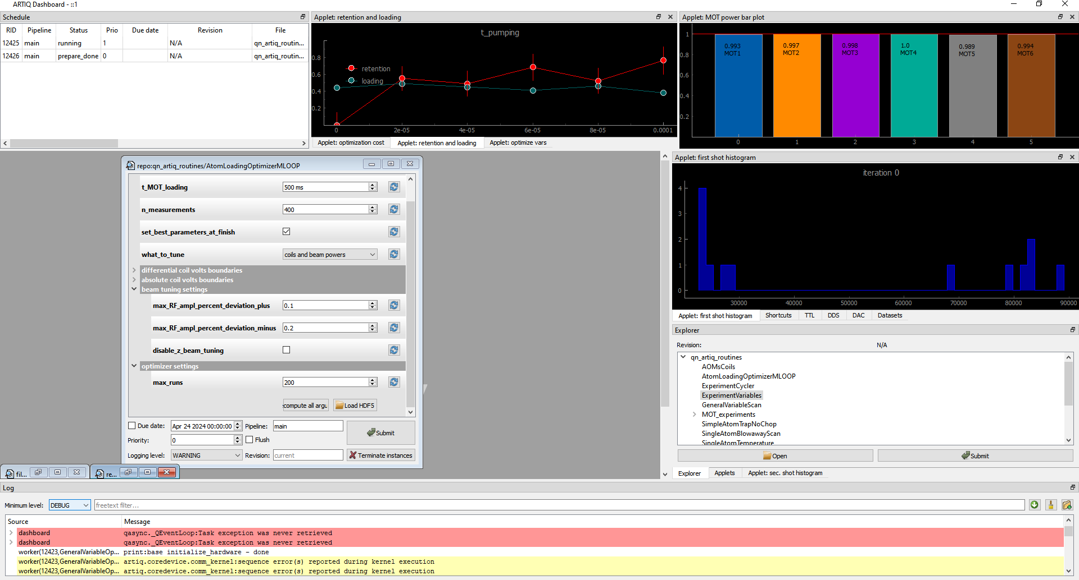
A brief look at the ARTIQ Dashboard
The Dashboard is the typical way of running experiments and viewing output.
The Schedule shows experiments that are running, and queued to run
Applets can allow you to visualize data as it is coming in from the experiment, for diagnostic purposes
The GUIs for experiments can be organized here or minimized, maximized, etc
The GUIs allow you to enter experiment parameters and run your experiment.
The names of your experiment classes show up here in Explorer
Your errors and print/logging statements show up here ;)

Slide 6
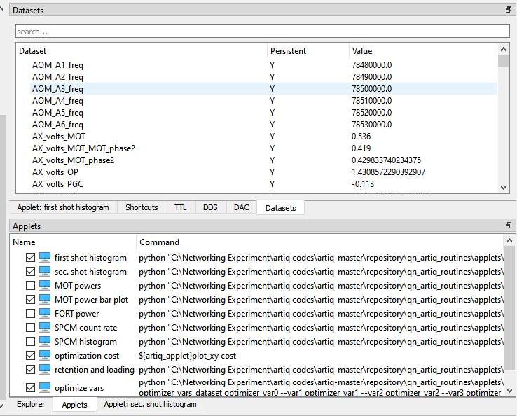
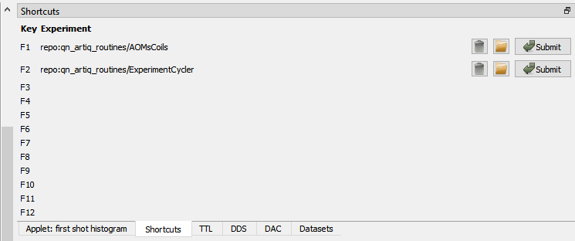
A brief look at the ARTIQ Dashboard
The Dashboard is the typical way of running experiments and viewing output.
You can also view the values of datasets here
Keyboard shortcuts can be assigned so that you can easily run common experiments
And define applet shortcuts here. More on these later.

Slide 7
The code repository
All of the code described here is in the group’s GitHub in the qn_artiq_routines repo (https://github.com/QuantumQuadrate/qn_artiq_routines)
Don’t download the code from GitHub. Be smart. git exists. ;)

Slide 8
The backbone of qn_artiq_routines
ExperimentVariables.py: enables straightforward sharing experiment variables across experiments
BaseExperiment.py: does all of the hardware and variable setup that is common to the vast majority of experiments
GeneralVariableScans.py: allows scanning experiments over any ExperimentVariable
GeneralVariableOptimizer.py: allows optimizing an experiment over several of ExperimentVariables

Slide 9
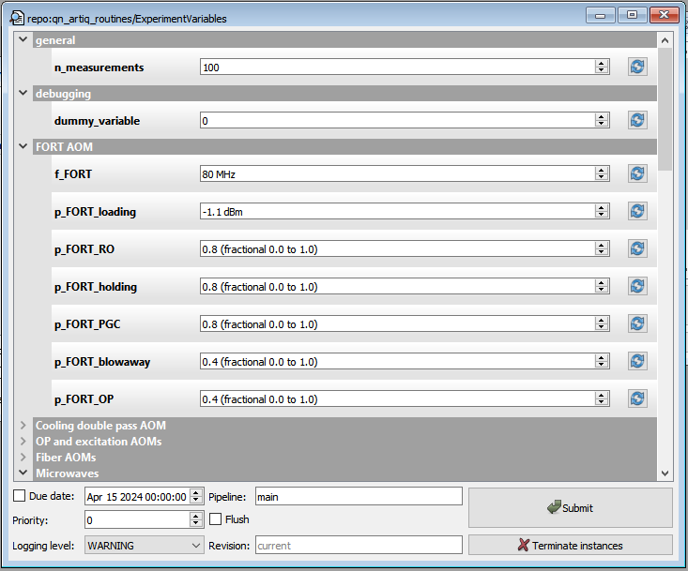
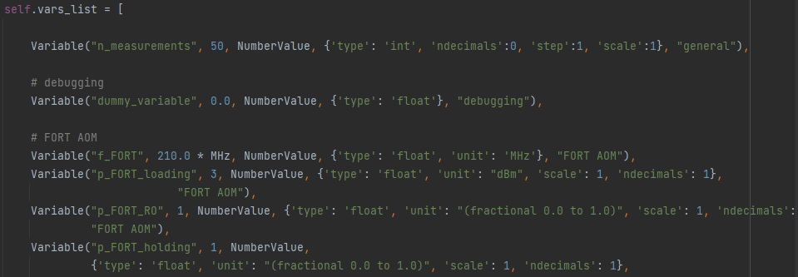
ExperimentVariables.py
ARTIQ uses “datasets” which can be used to broadcast data of essentially any numpy type (array, int, float64, object, etc)
When running experiments, we often tune one parameter, say the detuning of the MOT light, which shows up in many different experiments. Rather than hardcoding that value in every single experiment you run, we can take advantage of ARTIQ datasets to declare the variable values in one place, so we can reference them in any experiment code.
ExperimentVariables creates persistent ARTIQ datasets from the GUI arguments. The datasets are broadcast, meaning that you can reference them from other experiments, by doing something like “dummy_variable = self.get_dataset(“dummy_variable”)
Variables are defined in ExperimentVariables.py vars_list, so this. This is where you would add new variables.
Variable categories
…
The default value (red box) is only used the very first time you hit refresh all variables to show your new variable. After that, the code loads the value from the persistent dataset.

Slide 10
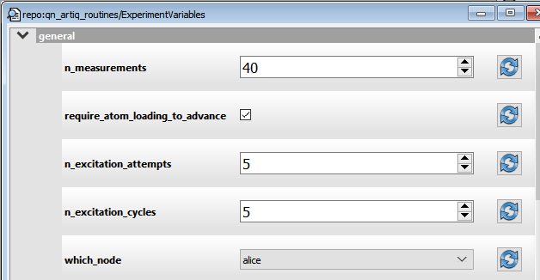
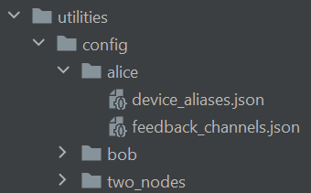
ExperimentVariables.py
Some key variables in the General group
The number of times to run an experiment loop for one setting of experiment parameters
If checked, n_measurements will refer to how many atoms are required to be loaded for a given setting of experiment parameters
Determines which json files are used for defining feedback channels and device aliases, as these might differ between our two nodes

Slide 11
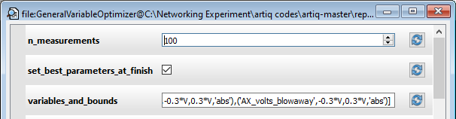
ExperimentVariables.py
Potential Pitfalls
Other experiments can update the datasets created by ExperimentVariables, such as our optimization code. For example, the checked box here means that the datasets for the variables mentioned in variables_and_bounds will be updated at the end of the experiment.
!!! The code above does not* update the GUI in ExperimentVariables.py, so you have to remember to “Recompute all arguments” after you run optimization (this is just so that the next time you run ExperimentVariables you do not accidentally overwrite the optimized values with the old ones).
*In fact, updating the GUI from within an experiment is apparently not possible.

Slide 12
DeviceAliases.py
DeviceAliases assigns nicknames to hardware channels so we can refer to them by function rather than a number (e.g. dds_FORT instead of urukul0_ch2). This code isn’t interacted with directly very often, but is important under the hood. It is mainly used within BaseExperiment.
The aliases themselves are defined by a dictionary in utilities/config/your_node/device_aliases.json. The same file contains the datasets which store default dds power and frequency values.
The names of ARTIQ hardware channels (e.g. urukul0_ch2, ttl13, etc) are defined in device_db.py, so we could have simply renamed the channels there. However, a benefit of DeviceAliases is that it simply creates a variable which points to the device channel, so we can still use the name given in the database if we want to, for low level debugging.
DeviceAliases also takes care of initializing Urukul channels, and dictates which variables for frequency and power are the defaults. Right now, DeviceAliases is mainly used for the Urukul channels, while ttl channels are named in BaseExperiment. This may change in the future.

Slide 13
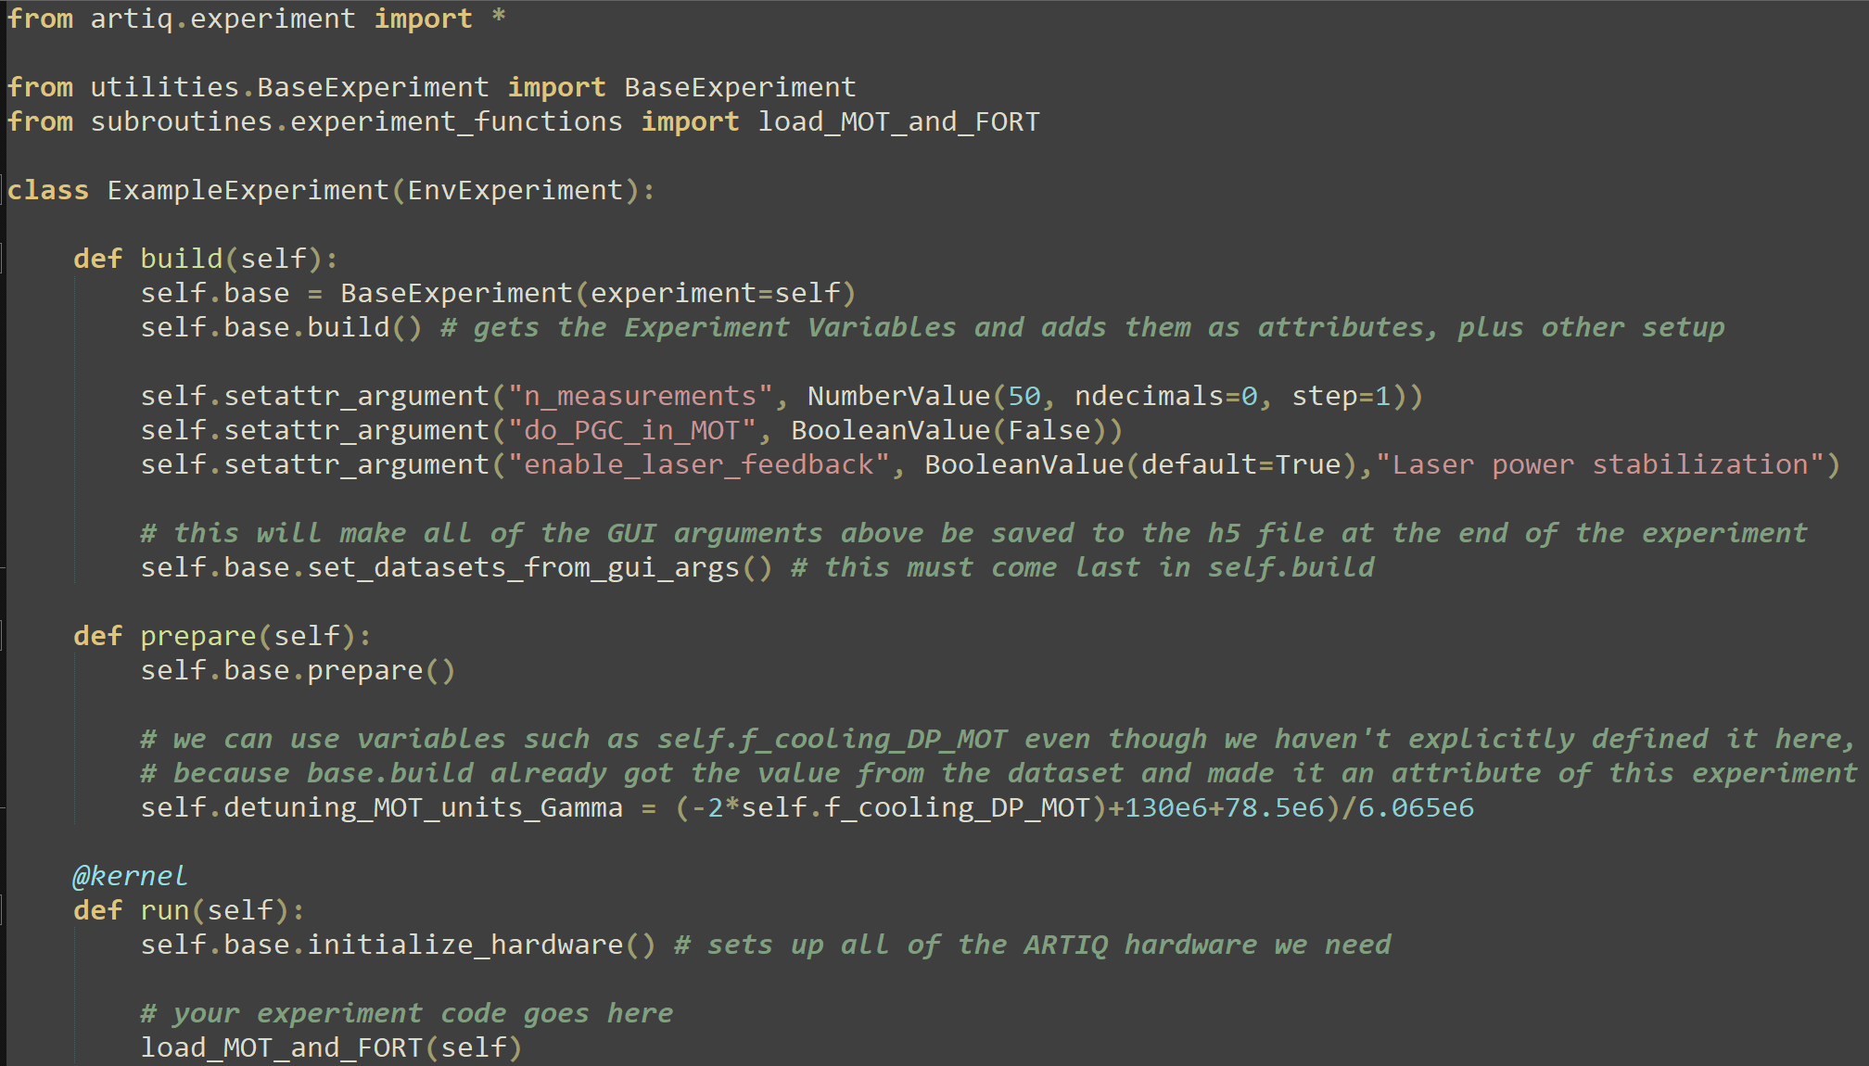
BaseExperiment.py
The BaseExperiment class reduces redundancy in our experiments so we don’t have to rewrite or copy/paste a bunch of common code, since most of the experiments we write have a lot in common– they all initialize ARTIQ devices like the core, Urukul, etc. We also regularly use variables defined in ExperimentVariables in multiple experiments.
The main methods of BaseExperiments are
build, prepare, and initialize hardware, and they are intended to be used in your experiment as shown. There is also set_datasets_from_gui_args, which does what it says. If you don’t use that, the arguments you enter in the GUI won’t be saved in the h5 file generated by the experiment. Seems like an oversight by the ARTIQ team? I thought so too.

Slide 14
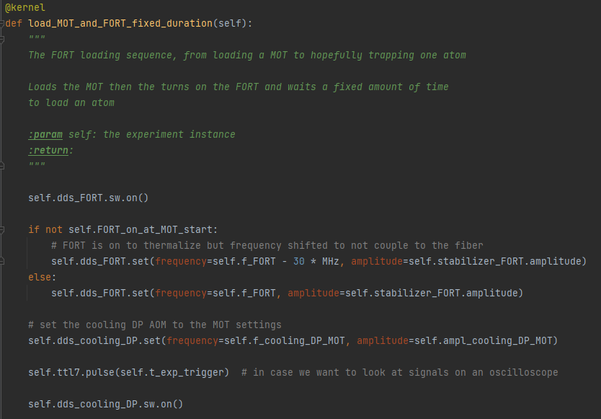
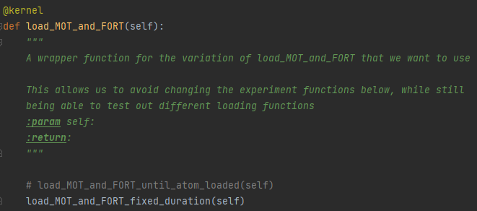
experiment_functions.py
In the last slide, notice that I imported “load_MOT_and_FORT” from subroutines.experiment_functions. If there is an experiment section that you think is likely to be used in many different places, you should put it in experiment_functions.py. This helps us ensure consistent and expected behavior across multiple experiments. Plus, if you find a bug, you only have to fix it in one place.
You can nest functions. This function is called inside of
Load_FORT_and_MOT, because I was testing different variations and didn’t want to change “load_FORT_and_MOT” throurhgout all the experiment code to test my different versions.
In experiment_functions…
The functions in experiment functions should take “self” as an argument, so that they can reference your experiment when you call them. This gives the function access to all of the ExperimentVariables and any other datasets.
In your code, call the function like this

Slide 15
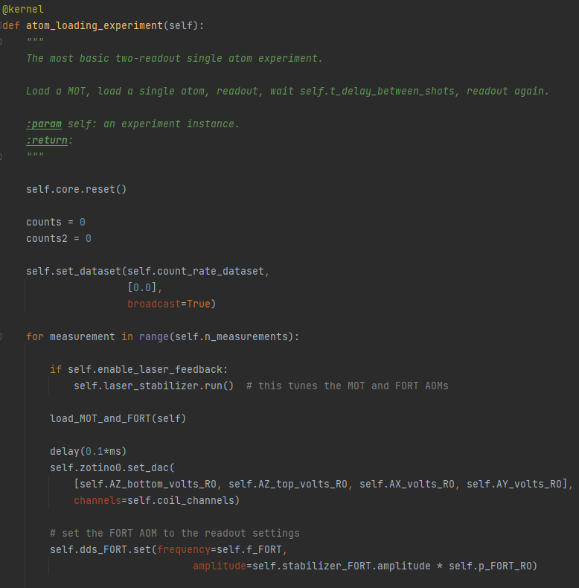
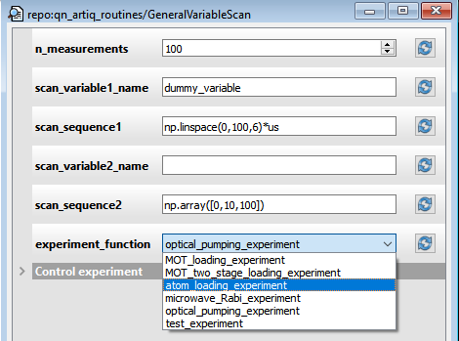
experiment_functions.py
You can also have entire experiments that get called by other code such as GeneralVariableScan (to be discussed next).
These functions should have names that end with “experiment“, so other code can find them.
…

Slide 16
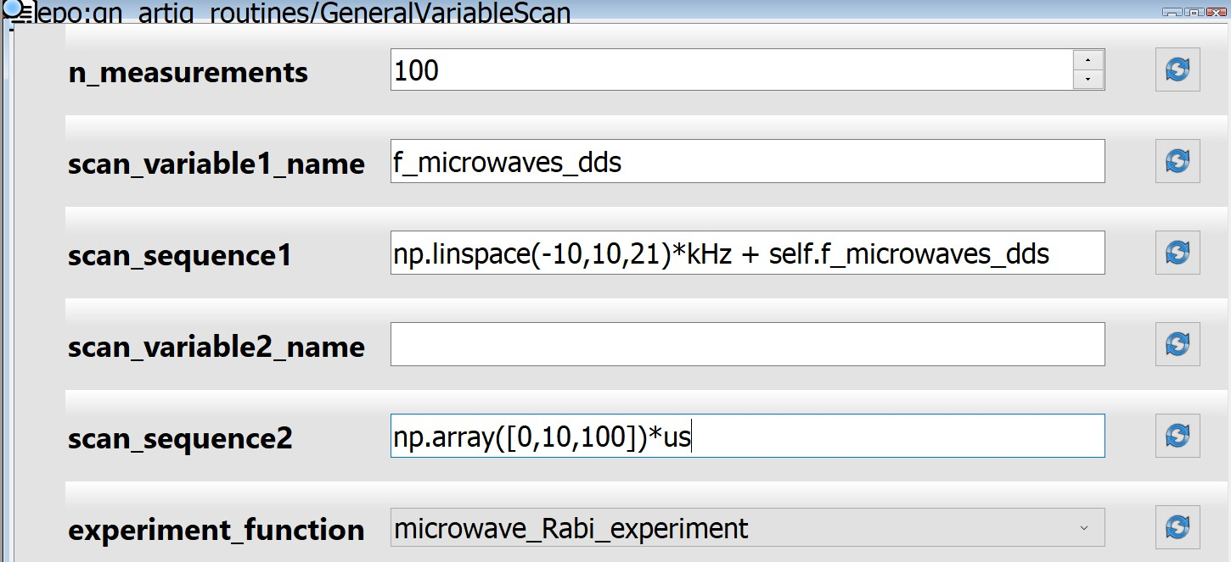
GeneralVariableScan.py
GeneralVariableScan allows us to scan experiments over any ExperimentVariable that we want to, without writing a dedicated experiment to do so. Scans can be done in 1D or 2D, over any steps that are a valid python sequence.
The number of measurements per scan step
(a scan step is also called an “iteration”)
Any variable defined in ExperimentVariables.
“self.” is not needed here.
Note that you can use numpy functions, ARTIQ units, and even ExperimentVariables as long as you remember the “self.”
scan_variable2_name is blank, so this will just be a 1D scan
This is any function that you write in subroutines/experiment_functions.py. As long as the function name ends with “experiment”, it will show up in this menu. See subroutines/experiment_functions.py for examples and more details.
Note: although the code changes the value of the scan_variable(s) through the experiment, it does not update the dataset for that variable. So whatever experiment you run after this will still use the value stored in the dataset before you ran this (i.e. the value displayed in ExperimentVariables if you “Recompute all arguments”)
For single atom experiments, you can plot the retention and loading rate with the “plot_retention_and_loading” applet. See applet section for details.

Slide 17
GeneralVariableScan.py
GeneralVariableScan allows us to scan experiments over any ExperimentVariable that we want to, without writing a dedicated experiment to do so. Scans can be done in 1D or 2D, over any steps that are a valid python sequence.
The number of measurements per scan step
(a scan step is also called an “iteration”)
Any variable defined in ExperimentVariables.
“self.” is not needed here.
Note that you can use numpy functions, ARTIQ units, and even ExperimentVariables as long as you remember the “self.”
scan_variable2_name is blank, so this will just be a 1D scan
See next page
This is any function that you write in subroutines/experiment_functions.py. As long as the function name ends with “experiment”, it will show up in this menu. See subroutines/experiment_functions.py for examples and more details.
Note: although the code changes the value of the scan_variable(s) through the experiment, it does not update the dataset for that variable. So whatever experiment you run after this will still use the value stored in the dataset before you ran this (i.e. the value displayed in ExperimentVariables if you “Recompute all arguments”)
For single atom experiments, you can plot the retention and loading rate with the “plot_retention_and_loading” applet. See applet section for details.

Slide 18
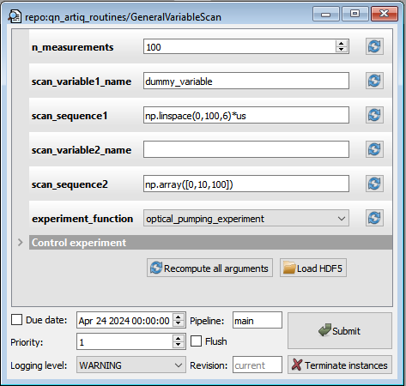
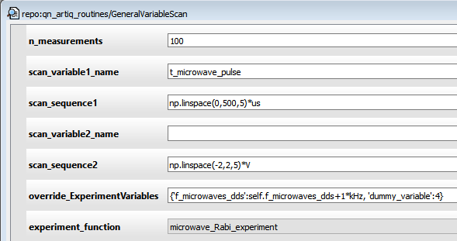
GeneralVariableScan.py
Pro-tips
You can use ‘override_ExperimentVariables’ to run an experiment without having to change the values set in ExperimentVariables. This will only change the variable for this experiment, i.e. it will not update the dataset. This is nice for avoiding errors due to changing an ExperimentVariable and forgetting to change it back.
If you scan over ‘dummy_variable’, you can check if your experiment is behaving consistently. You can also put self.dummy_variable in your code as a stand-in or temporary variable to test things out.
A python dictionary with the key(s) equal to variable names, and values equal to the value(s) you want.

Slide 19
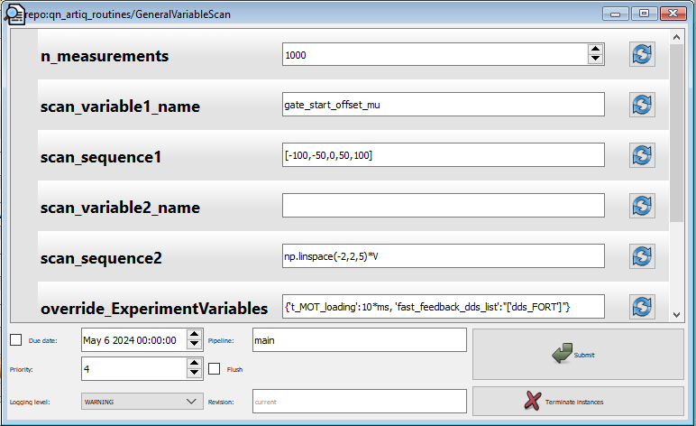
GeneralVariableScan.py
Pro-tips
Another example of overriding ExperimentVariables
Below, I was running experiment in which I physically blocked the cooling laser, so
I disabled the feedback by setting fast_feedback_dds_list to only include the FORT AOM. Note the double quotations which are needed around [‘dds_FORT’].
I set the MOT loading time to only 10*ms (could be shorter) to improve my data rate, since I clearly wasn’t going to load any atoms.

Slide 20
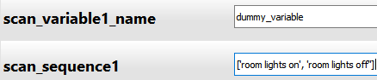
GeneralVariableScan.py
Pro-tips
If you want to save a note about the experiment you are running, you can do this with dummy_variable. This can be set in the override_ExperimentVariables as well. The reason there is no dedicated note section is that unless you remember to update the note every run, it quickly becomes untrustworthy.
When you want to “scan over” a physical change in the lab, i.e. change something between experiment iterations, you can enter what you did as a dummy variable sequence:

Slide 21
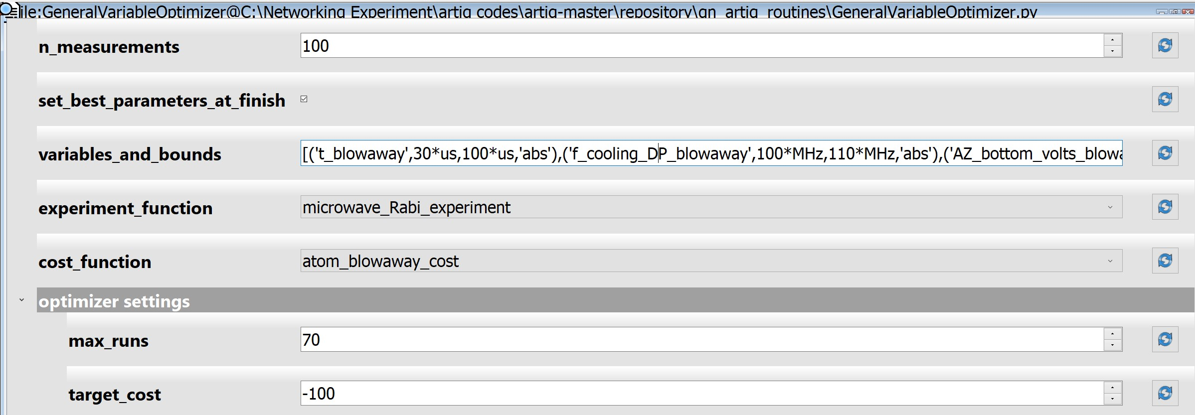
GeneralVariableOptimizer.py
GeneralVariableOptimizer allows us to optimize experiments over several variables at once, using Bayesian optimization.
The optimization is based on M-LOOP https://m-loop.readthedocs.io/en/stable/
You can optimize any function over any ExperimentVariable, as long as you can quantify your goal in the form of a “cost”
The ExperimentVariable datasets will be updated at the end with the best values found
The number of attempts M-LOOP will make, unless it reaches the target cost sooner than this
The best value your cost function could return
A function defined in subroutines/cost_functions.py which returns a number, e.g. how many -1*(how many atoms were retained). As long as your function name ends with “cost”, it will show up in this list. See cost_functions.py for examples.

Slide 22
GeneralVariableOptimizer.py
There are several ways to specify boundaries for each variable, some more useful than others depending on the situation.
variables_and_bounds is a list of the format [(‘variable_name’,min_value,max_value,’boundary_type’), …]
‘boundary_type’ specifies how to treat the min and max values given. There are 3 options:
‘abs’: absolute. E.g., [(‘t_blowaway’, 30*us, 100*us, ’abs’)] would be scanned from 30*us to 100*us.
Absolute boundaries are good for when there is a hardware limitation you have to consider,
such as the maximum amount of current that the coil drivers can draw.
‘diff’: differential, with respect to the default value.
e.g. if t_blowaway = 50*us in ExperimentVariables,
[(‘t_blowaway’, -30*us, 30*us, ’diff’)] would be scanned from 20*us to 80*us
3. ‘perc’: percentage, with respect to the default value.
e.g. if t_blowaway = 50*us in ExperimentVariables,
[(‘t_blowaway’, 0.5, 2.0, ’perc’)] would be scanned from 25*us to 100*us.
This type of boundary specification might be useful if you are tuning laser powers, where the absolute voltage measured from the detector doesn’t mean much, and varies detector to detector.

Slide 23
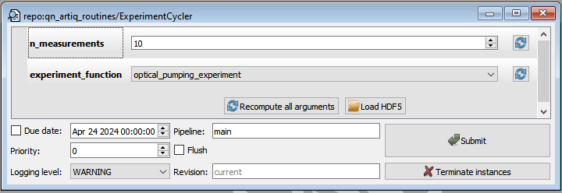
ExperimentCycler.py
This is a priority 0 experiment that can be run in the interest of maintaining thermal stability in the experiment hardware. Whenever you run another experiment which is higher priority, it will pause, let your experiment run, and then resume at the end.
I typically set n_measurements to 10. The experiment only pauses to check if there is an experiment in the queue after n_measurements have finished, and you don’t want to wait 3 minutes for your experiment to run.
You can set the priority of other experiments to be 1 if you want this experiment to pause for them.

Slide 24
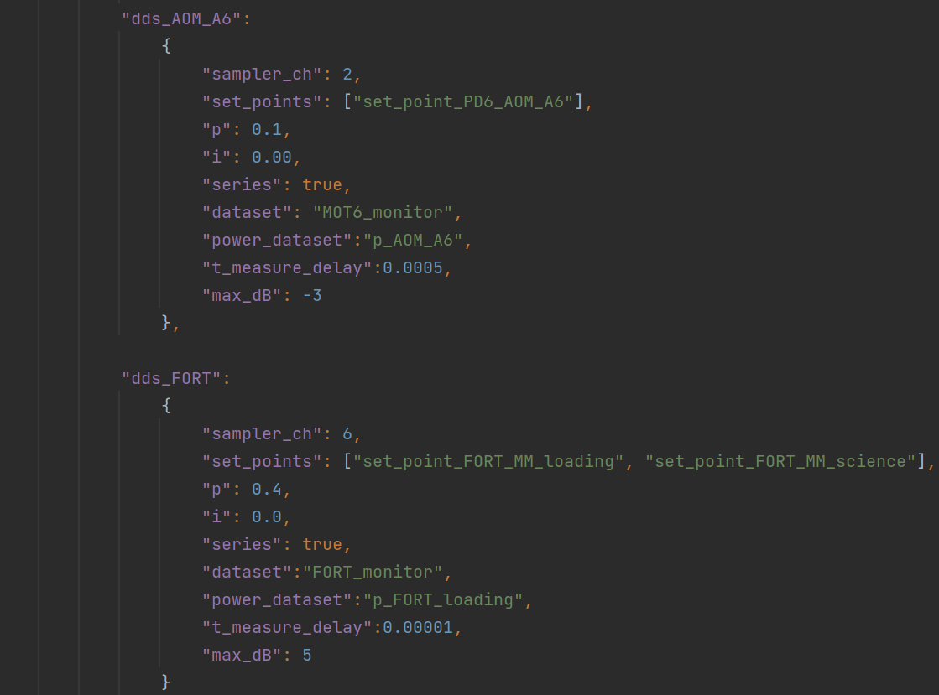
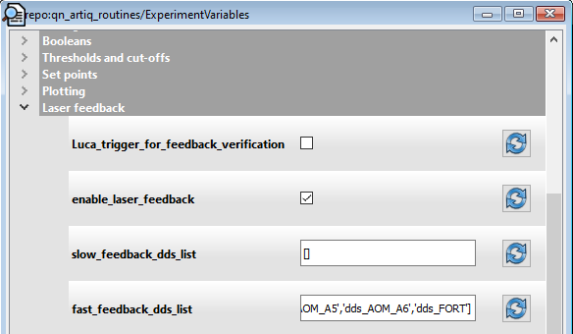
aom_feedback.py
This is the code responsible for implementing DC power stabilization of our lasers using AOMs, including but not limited the fiber AOMs and the FORT AOM. This code allows you feedback to the RF power output by Urukul channels based on reading a voltage. The typical use case is when the Urukul channel is controlling an AOM and the voltage signal reads a photodiode after the AOM. Note that this is not a servo loop, which has already been implemented as an ARTIQ instrument; this feedback code runs only when we tell it to, for example to tune the Urukul power before we do an experiment.
There are two main classes: FeedbackChannel, and AOMPowerStabilizer.
FeedbackChannel allows us to define a feedback object consisting of a name, an Urukul channel, and various defaults for the feedback (gain, etc). The FeedbackChannel objects are initialized by AOMPowerStabilizer when it is instantiated, i.e. you will likely never directly deal with FeedbackChannel.
The FeedbackChannel objects that are created depend on which dds’s you specify. Assuming that you are using BaseExperiment, this is given by the ‘fast_feedback_dds_list’.
Feedback settings by channel are defined in a dictionary in
utilities/config/your_node/feedback_channels.json
Setup
Which AOMs we apply feedback to:
The information that will go into FeedbackChannel objects is grouped by the Sampler cards which are used to measure the photodetector signals. Every urukul channel that you want to feed back to needs to have an entry in this dictionary, even if you do not always want to feedback to it.
…
These are the names of urukul channels which are defined in DeviceAliases, and this list determines which AOMs we adjust in an experiment when AOMPowerStabilizer is run.

Slide 25
aom_feedback.py
The feedback loop itself is in AOMPowerStabilizer.run, but the actual feedback application is in FeedbackChannel.feedback, which implements a simple PI (proportional, integral) feedback step.
Key points:
FeedbackChannels can be series or parallel, meaning their feedback loops will run in series or parallel. Feeding back in series is obviously slower to run, but this is necessary in cases where one detector is used for more than one beam (e.g. we could use i2V PD6 to adjust AOM A6 as well as the pumping repump AOM since both beams use that optical path), or if there is scattering into a detector from another beam (this is the case with MOT1/3 and MOT2/4)
Feedback settings by channel are defined in a dictionary in
utilities/config/your_node/feedback_channels.json
Setup
Which AOMs we apply feedback to:
The information that will go into FeedbackChannel objects is grouped by the Sampler cards which are used to measure the photodetector signals. Every urukul channel that you want to feed back to needs to have an entry in this dictionary, even if you do not always want to feedback to it.
Note that there can be more than one set point dataset,
which allows calling the feedback to adjust a specific channel to a number of different setpoints
…
These are the names of urukul channels which are defined in DeviceAliases, and this list determines which AOMs we adjust in an experiment when AOMPowerStabilizer is run.

Slide 26
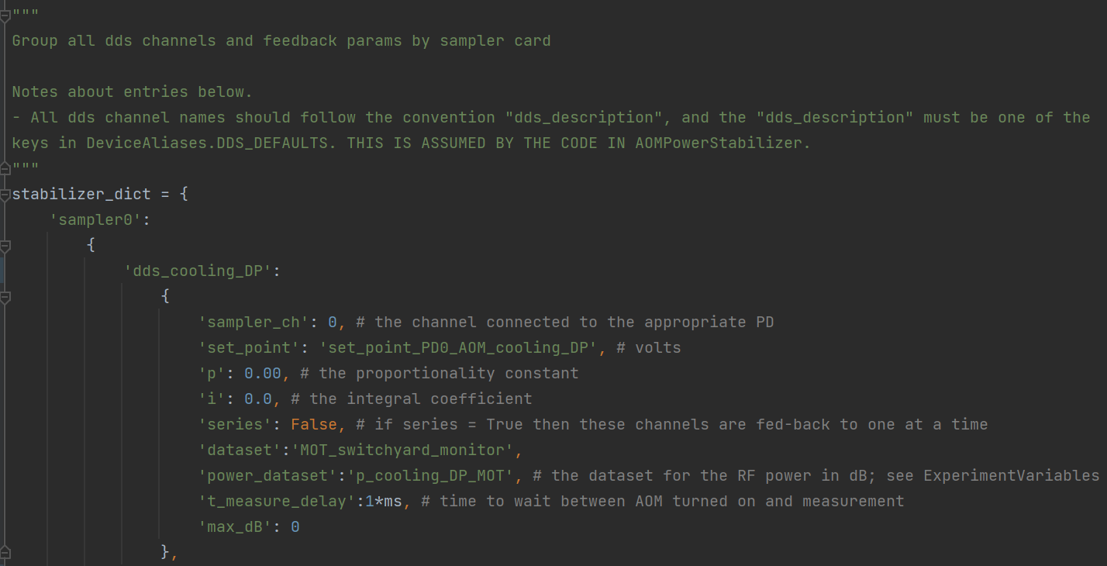
aom_feedback.py (pre June 2024)
This is the code responsible for implementing DC power stabilization of our lasers using AOMs, including but not limited the fiber AOMs and the FORT AOM. This code allows you feedback to the RF power output by Urukul channels based on reading a voltage. The typical use case is when the Urukul channel is controlling an AOM and the voltage signal reads a photodiode after the AOM. Note that this is not a servo loop, which has already been implemented as an ARTIQ instrument; this feedback code runs only when we tell it to, for example to tune the Urukul power before we do an experiment.
There are two main classes: FeedbackChannel, and AOMPowerStabilizer.
FeedbackChannel allows us to define a feedback object consisting of a name, an Urukul channel, and various defaults for the feedback (gain, etc). The FeedbackChannel objects are initialized by AOMPowerStabilizer when it is instantiated, i.e. you will likely never directly deal with FeedbackChannel.
The FeedbackChannel objects that are created depend on which dds’s you specify. Assuming that you are using BaseExperiment, this is given by the ‘fast_feedback_dds_list’.
Feedback settings by channel are defined in subroutines/aom_feedback.py
Setup
Which AOMs we apply feedback to:
The information that will go into Feedback channel objects is defined in stabilizer_dict, grouped by the Sampler cards which are used to measure the photodetector signals. Every urukul channel that you want to feed back to needs to have an entry in this dictionary, even if you do not always want to feedback to it.
…
These are the names of urukul channels which are defined in DeviceAliases, and this list determines which AOMs we adjust in an experiment when AOMPowerStabilizer is run.

Slide 27
aom_feedback.py (pre June 2024)
The feedback loop itself is in AOMPowerStabilizer.run, but the actual feedback application is in FeedbackChannel.feedback, which implements a simple PI (proportional, integral) feedback step.
Key points:
FeedbackChannels can be series or parallel, meaning their feedback loops will run in series or parallel. Feeding back in series is obviously slower to run, but this is necessary in cases where one detector is used for more than one beam (e.g. we could use i2V PD6 to adjust AOM A6 as well as the pumping repump AOM since both beams use that optical path), or if there is scattering into a detector from another beam (this is the case with MOT1/3 and MOT2/4)
Feedback settings by channel are defined in subroutines/aom_feedback.py
Setup
Which AOMs we apply feedback to:
The information that will go into Feedback channel objects is defined in stabilizer_dict, grouped by the Sampler cards which are used to measure the photodetector signals. Every urukul channel that you want to feed back to needs to have an entry in this dictionary, even if you do not always want to feedback to it.
…
These are the names of urukul channels which are defined in DeviceAliases, and this list determines which AOMs we adjust in an experiment when AOMPowerStabilizer is run.

Slide 28
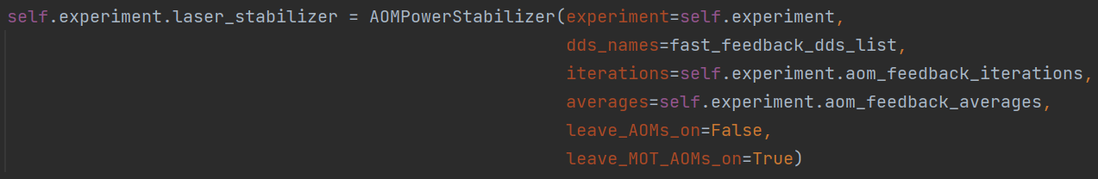
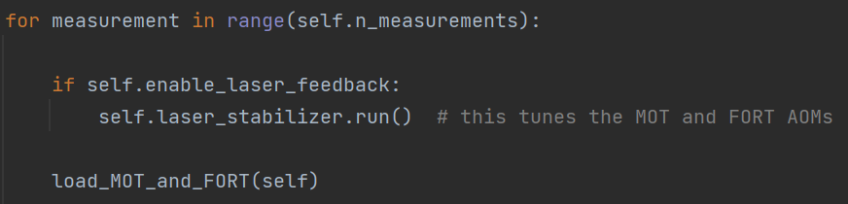
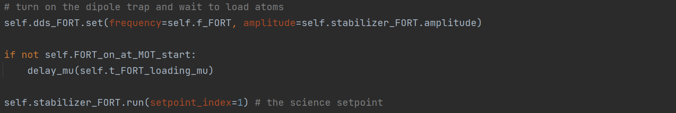
aom_feedback.py
Setup
In order to use the stabilizer, you first instantiate the AOMPowerStabilizer as shown below. This is done in BaseExperiment
with whatever defaults we set with ExperimentVariables, so you shouldn’t need to manually implement this. See BaseExperiment for details.
Number of feedback steps in the PI loop for each channel
Number of measurements taken with the Sampler for one error measurement in the PI loop
The arguments used in this snippet from BaseExperiment are found in ExperimentVariables in the Laser feedback section.
Running the feedback
Typically, we call run() at the beginning of an experiment sequence, before doing anything else. This will use the default set point datasets, which are the zeroth elements in the list.
To stabilize a FeedbackChannel with a set point other than the default, run feedback on that specific channel
setpoint_index=1 means the feedback will use the 1st element in this list

Slide 29
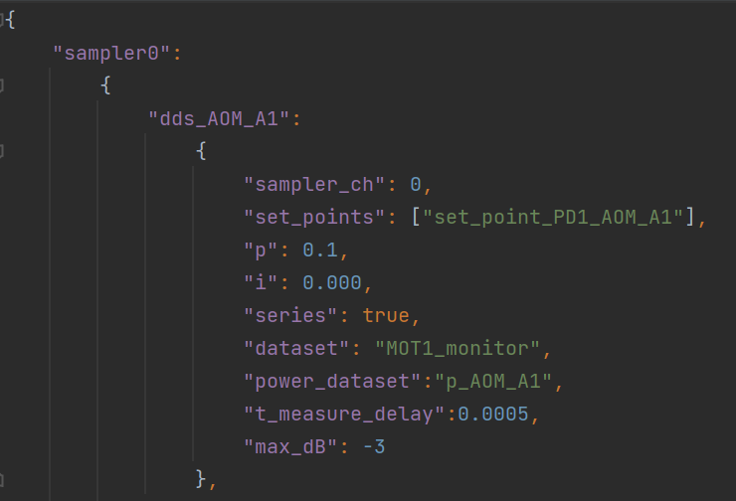
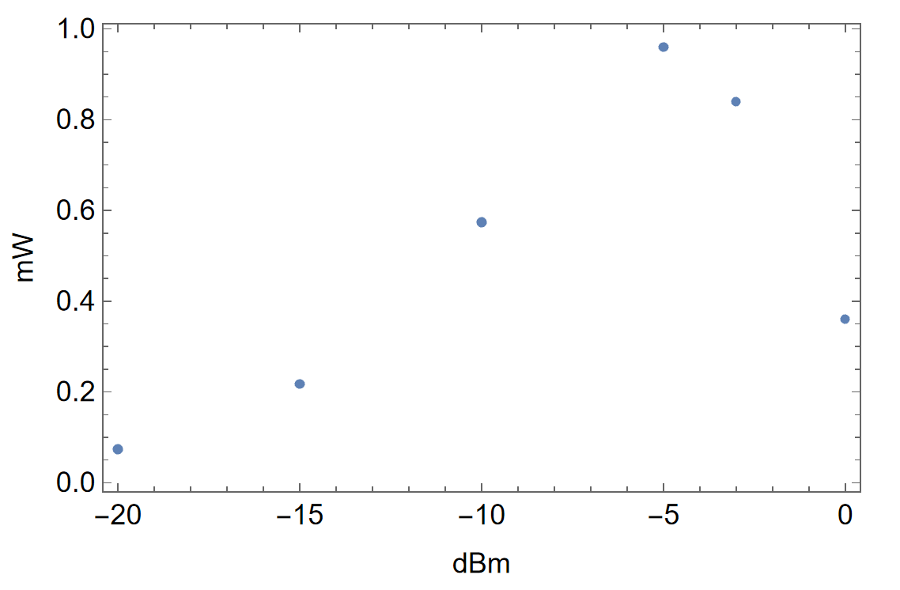
aom_feedback.py
Potential pitfalls
Feedback settings by channel are defined in subroutines/aom_feedback.py
Fiber AOM diffraction efficiency
Optical power
Power before the amplifier
The effective transfer function of the loop is not truly linear, so using a proportional term p which is a constant only works when the AOM is operated in a region for which the AOM is linear. This assumption is valid if the AOM is being operated at a low enough power (e.g. < -5dBm in the plot at the right for a fiber AOM) and the power drift is small enough that the AOM will stay in that good range. If your laser power drops significantly, the feedback may push the RF power up to “max_dB”, at which point the slope becomes negative and the feedback loop would not be able to go back the correct direction. To deal with this, if the maximum is reached, the feedback loop will set the RF to a low power, say -20 dBm, and try again. So if you see a particular beam power oscillating (e.g. as viewed in the MOT powers applet), you should increase the laser power, typically by improving fiber coupling.

Slide 30
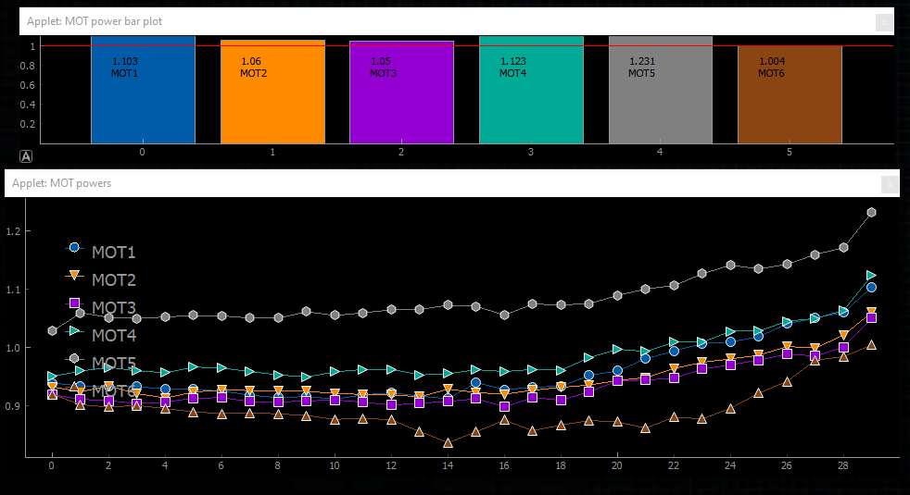
aom_feedback.py
Monitoring beam drift without feedback
If you call run(monitor_only=True), the measurements of the beam powers will be made as usual and the datasets will be updated, but there will not be any feedback applied. The applets below show the beam powers wandering around in this mode.

Slide 31
Applets
Applets are ARTIQ’s way of visualizing the contents of datasets, and they can be updated as the datasets change throughout your experiment.
The utility in this is that it allows you to see right away if something is working or not working (e.g. if you lose atom loading), rather than waiting until your entire experiment runs to analyze the data.
ARTIQ’s built in applets are very basic, so I have written some additional ones that are of specific use to our experiments.
All of the applets discussed in the following slide live in qn_artiq_routines/applets. See the code for each for more details.

Slide 32
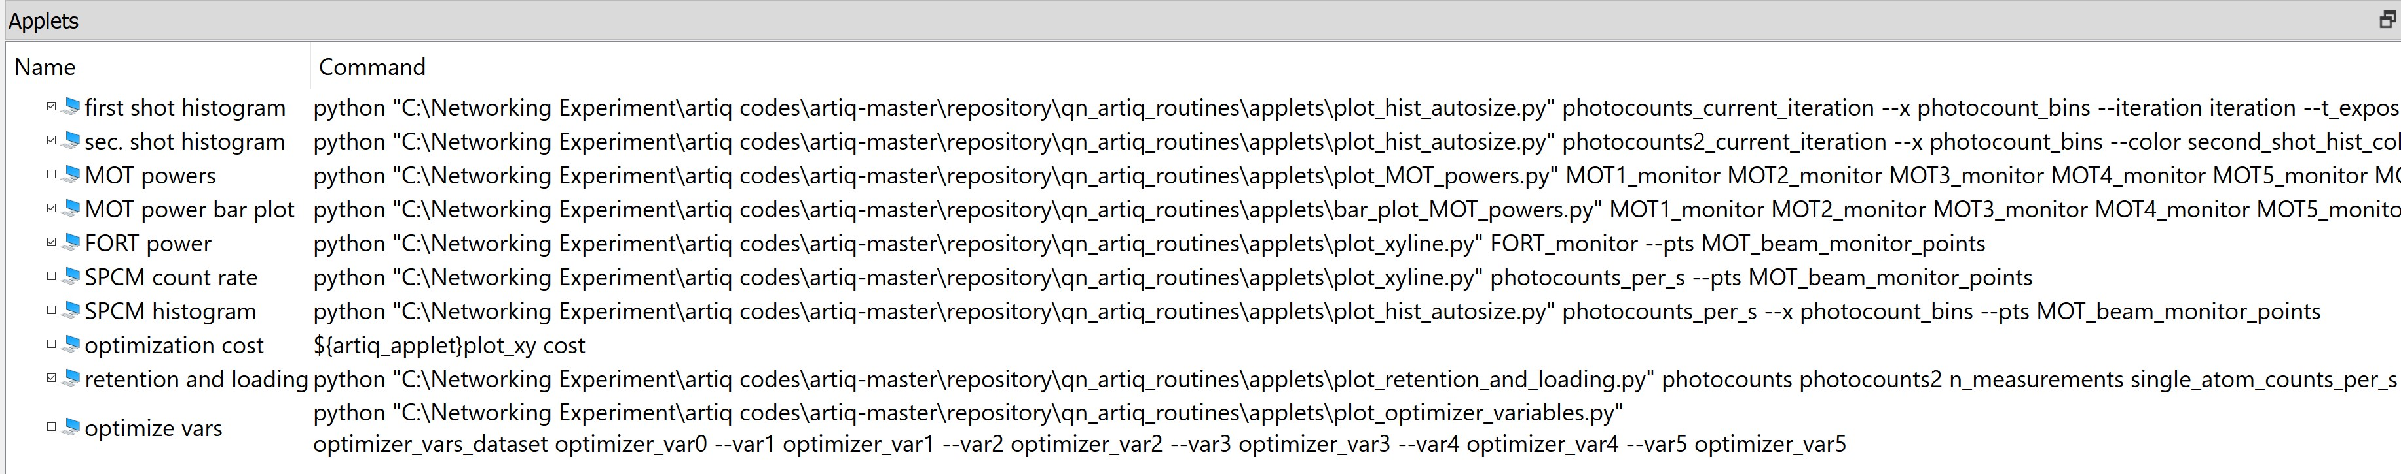
Launching applets
The easiest way to use applets is to make a shortcut in the Applets dock in the ARTIQ Dashboard, by right clicking. You enter a name, and the path to the applet along with the arguments for it, which specify data.
Note: more detail is given in the file for each applet, and the list of arguments are at the bottom of each file.
The custom applets that we define are referenced by the full path to the code
The arguments are all datasets that are defined in your experiment. For example, you will find photocounts_current_iteration in many of the experiments in experiment_functions.py
‘--name’ means the argument ‘name’ is optional, and the dataset that follows it is the argument. So here, “--var1” is the argument name, and optimizer_var1 is the dataset passed for that. See each specific applet .py file for details.
Note that we often use the same applet for plotting several datasets (see underlined applet names above)
Check the box to display the applet

Slide 33
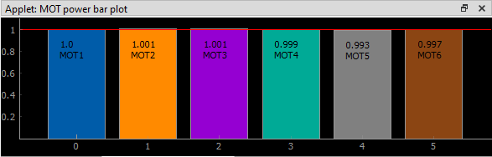
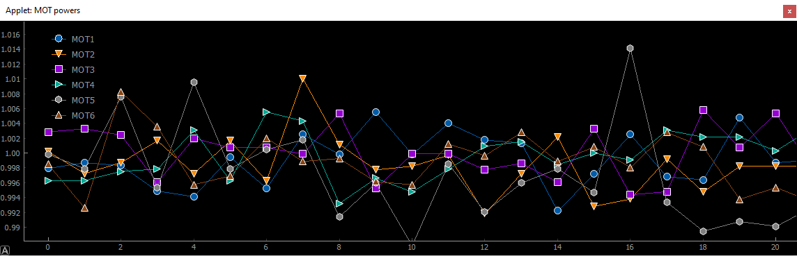
plot_MOT_powers and bar_plot_MOT_powers
Both of these display the MOT beam powers relative to their setpoints, but the bar plot is less resource intensive, as it only plots the most recent values (after the last feedback run)
plot_MOT_powers is a modified version of the applet plot_xy_multichannel

Slide 34
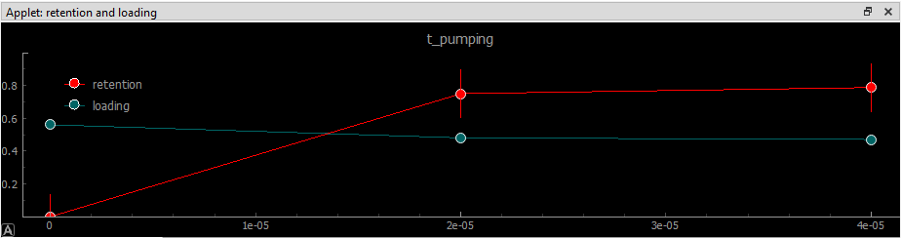
plot_retention_and_loading
Plots the fraction of atoms loaded and the fraction of atoms retained (retention) in a single atom experiment. This uses the photocount data together with single_atom_counts_per_s threshold defined in ExperimentVariables.
We typically keep two instances of this applet open, showing the photon counts for the first and second “shots” (readouts) in single atom experiments. The red outline of the second shot is set with an optional argument.
The applet command for “retention and loading” shown is:
python "C:\..\qn_artiq_routines\applets\plot_retention_and_loading.py" photocounts photocounts2 n_measurements single_atom_counts_per_s t_SPCM_first_shot --scan_vars scan_variables --scan_sequence1 scan_sequence1
Note the optional arguments that specify scan variables and scan sequences. These are defined and updated by GeneralVariableScan (you could define these in other experiments too), such that the variable being scanned will be the plot title, and the x axis will be the value of that variable.

Slide 35
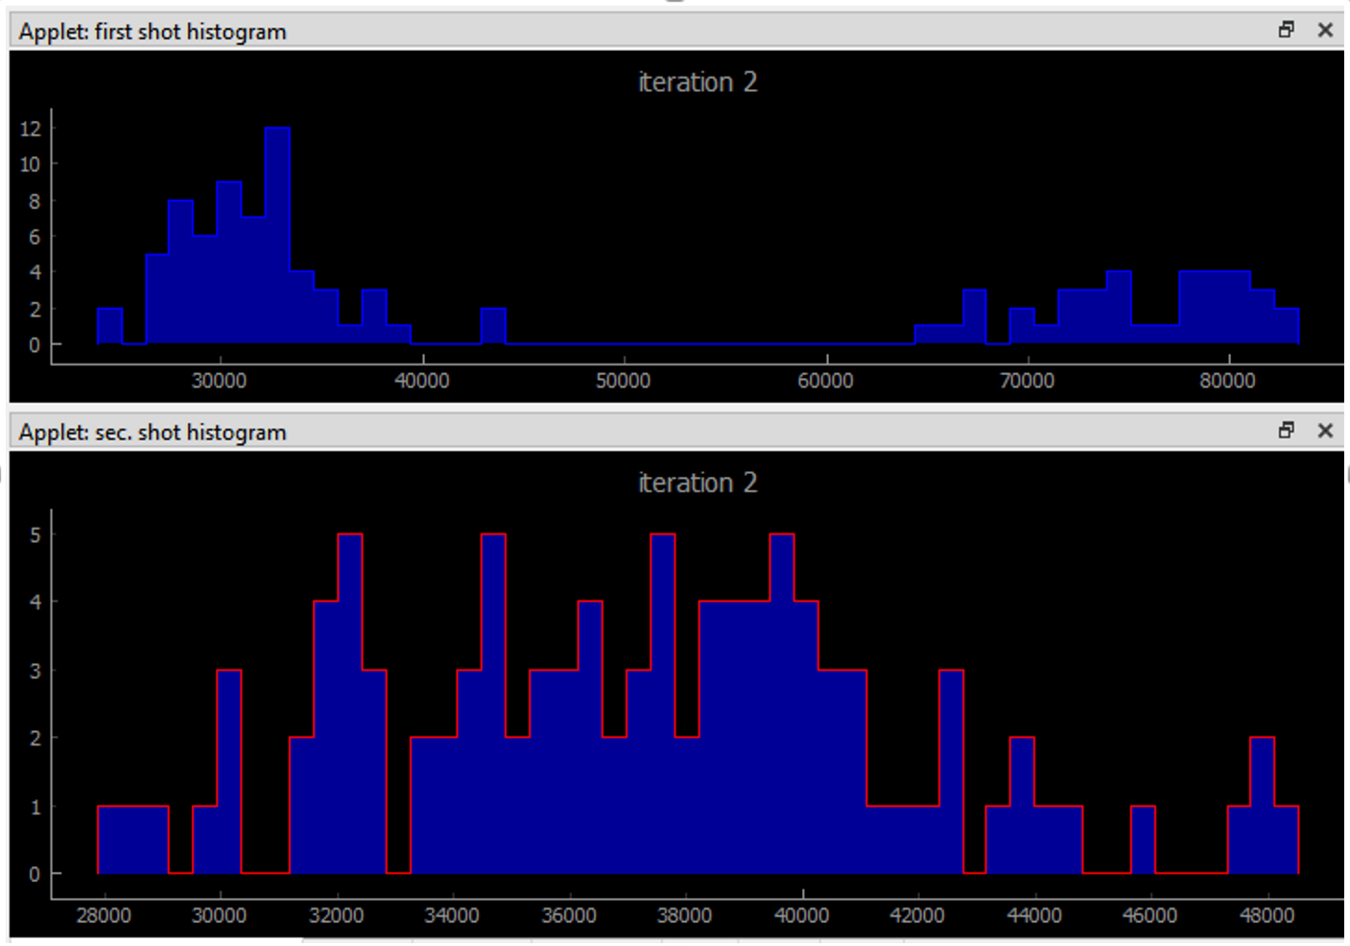
plot_hist_autosize
Plots a histogram of data, with the range of the histogram set by the data. The default histogram applet from ARTIQ makes the user pre-calculate the height of the bars, whereas plot_hist_autosize deals with the raw datasets.
We typically keep two instances of this applet open, showing the photon counts for the first and second “shots” (readouts) in single atom experiments. The red outline of the second shot is set with an optional argument.
The x axis by default is just the counts from the raw data (i.e. how many photons we counted), but here, optional argument is given to specify the exposure time, the x axis will be the count rate.
The command for the “sec. shot histogram” is:
python "C:\..\qn_artiq_routines\applets\plot_hist_autosize.py" photocounts2_current_iteration --x photocount_bins --color second_shot_hist_color --iteration iteration --t_exposure t_SPCM_second_shot
Pro-tip: This histogram applet could be used with any 1D data, not just photocounts, and the data can be normalized to any value depending on what is supplied as the –t_exposure argument.

Slide 36
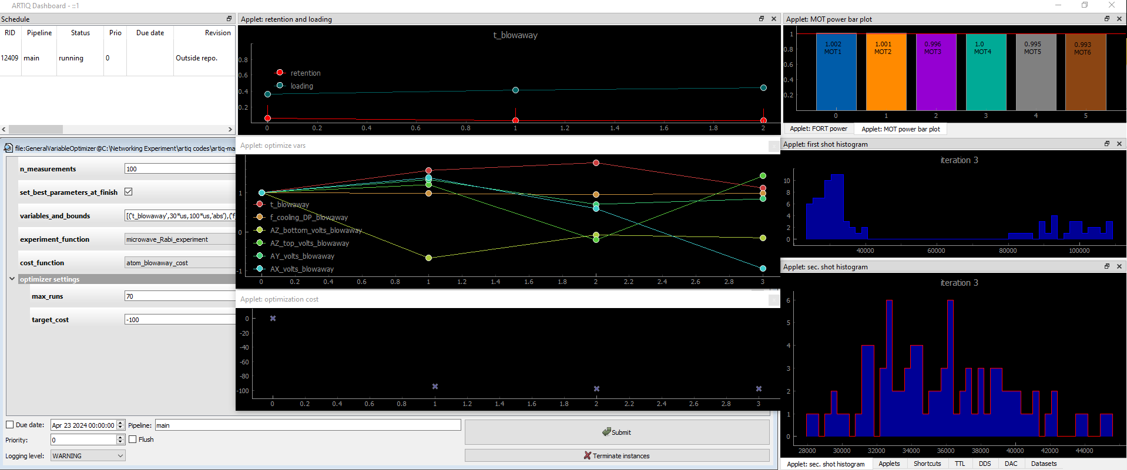
plot_optimizer_variables
Shows the values of the variables being optimized with GeneralVariableOptimizer at each iteration. If you also plot the cost dataset using ARTIQ’s xy plot applet, you can see how the cost evolves with the choice of parameters. Below is an example of how I might arrange the dashboard while doing optimization with GeneralVariableOptimzer.

Slide 37
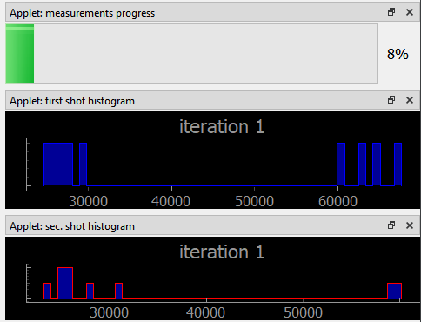
Progress bar
This is a built-in applet shipped with ARTIQ.
The command I use for plotting the percentage of measurements which have completed is:
${artiq_applet}progress_bar measurements_progress
This dataset stores the float value
measurement/self.n_measurements, and is currently only accessible through ExperimentCycler and GeneralVariableScan (i.e. the progress bar here wouldn’t progress for other experiments)

Slide 38
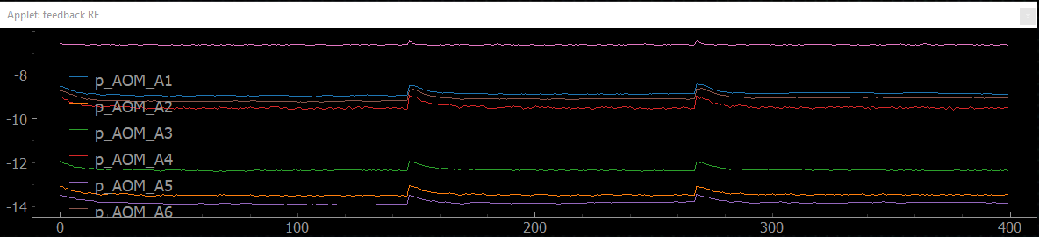
plot_xy_multichannel.py
This applet allows plotting multiple datasets as y vs x plots.
The command I use for plotting the RF powers in dBm for the FeedbackChannels (see aom_feedback.py slides) is:
python "C:\..\qn_artiq_routines\applets\plot_xy_multichannel.py" p_AOM_A1_history MOT_beam_monitor_points --y2 p_AOM_A2_history --y3 p_AOM_A3_history --y4 p_AOM_A4_history --y5 p_AOM_A5_history --y6 p_AOM_A6_history --y7 p_FORT_loading_history --labels feedbackchannels

Slide 39
Tutorials for select common tasks
Turning on AOMs and MOT coils for viewing the MOT in steady state
Manual tuning of coils and/or beam powers for finding a MOT
Manual tuning of coils and/or beam powers for finding single atoms
Optimizing single atom loading
And more!

Slide 40
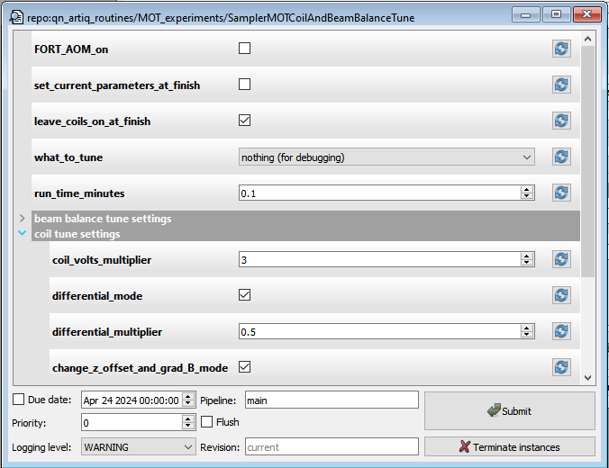
Finding a MOT
SamplerMOTCoilAndBeamBalanceTune allows manual tuning of the coil values and beam balances.
Outputs of potentiometer box is connected to a Sampler ADC, and you tune the potentiometer knobs. Those voltages are read by the Sampler and used to set values for the coils or beam powers. The MOT beams and coils will be on in steady state, and laser feedback can be run to keep the beam powers stabilized (even if you are adjusting the beam powers). You look for a MOT using a camera, such as Andor Luca, which is setup and controlled separately from ARTIQ (e.g. with Andor Solis).
There are four “what_to_tune” modes:
nothing, which will do… nothing ☺
Beams only
Coils only
Both
I typically leave this unchecked until I have a MOT, then stop the experiment and run it again for a short time with the box checked.
Multipliers for the potentiometer values. Only one of these is used, based on the differential mode option. These are useful for fine tuning and making sure you don’t exceed the hardware limits (e.g. maximum voltage output from Zotino)
If checked, the potentiometer will adjust the values with respect to the default values (i.e. those in ExperimentVariables)
Essentially a different basis. Instead of adjusting the Z coils independently, they gradient will be varied by one Z potentiometer channel, while the Z offset will be adjusted with the other.

Slide 41
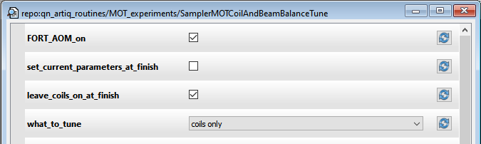
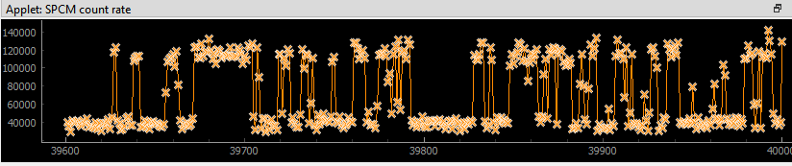
Finding single atoms
SamplerMOTCoilAndBeamBalanceTune can also be used to find single atoms, by turning the FORT on. The counts on an SPCM are read with ARTIQ, and the counts can be plotted in an applet. You do not need to first see a signal from the MOT itself on the SPCM. That signal is incredibly weak, and does not really help finding single atoms.
Check this.
Open the SPCM count rate applet which plots the photocount rate
This clear bi-modal behavior is the sign of atoms falling into and out of the FORT. The more rapidly the signal oscillates between atom trapped and no atom, the better your loading rate. However, you can’t meaningfully say what the loading rate is from this data.

Slide 42
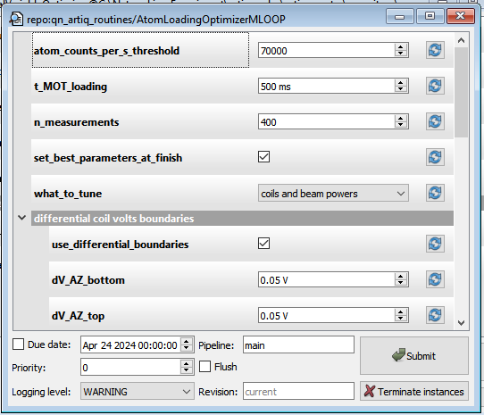
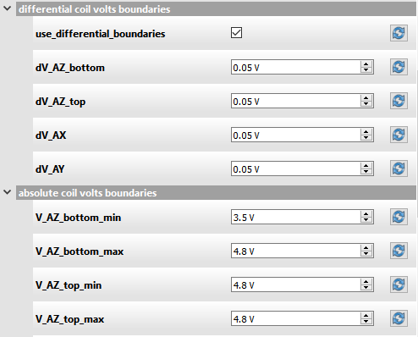
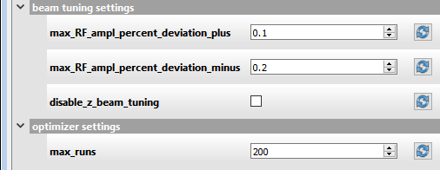
Optimizing atom loading (steady state MOT)
AtomLoadingOptimizerMLOOP can be used to maximize the number of atoms loaded when the MOT is loaded in steady state, and it can tune coils as well as beams. M-LOOP will sample the parameter space within the boundaries you specify and try to maximize the number of atoms that fall into and out of the trap in a given period of time.
The threshold count rate which classifies an event as an atom rather than background
How long to load the MOT while we count atoms
How many times to load the MOT and count the atoms in the t_MOT_loading interval. i.e., loading the MOT once and counting the atoms is one measurement.
Same as SamplerMOTCoilAndBeamBalanceTune
You can use either differential (relative to the default values) or absolute boundaries for coil volts. Differential is often easier. Either way, if you make the range too large M-LOOP will spend a lot of time sampling parts of the parameter space for which there is no MOT
The beam powers are tuned by adjusting the RF voltage amplitude to the fiber AOMs. The boundaries are specified for all 6 beams in terms of a percentage deviation. Here, the amplitude can range +10%/-20% of the default. Note this is not +10%/-20% of the beam power set point or the dB value in ExperimentVariables.
We can manually balance the Z beams and measure their powers since they are free space, so one strategy is not optimize the Z beams (this reduces the parameter space and can save time, even if the Z beams need to be tuned slightly eventually).

Slide 43
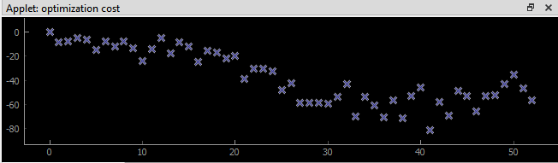
Optimizing atom loading (steady state MOT)
Again, you can open the SPCM count rate applet which plots the photocount rate
This would constitute one measurement, and the cost would return about -30, i.e. 30 atoms loaded

Slide 44
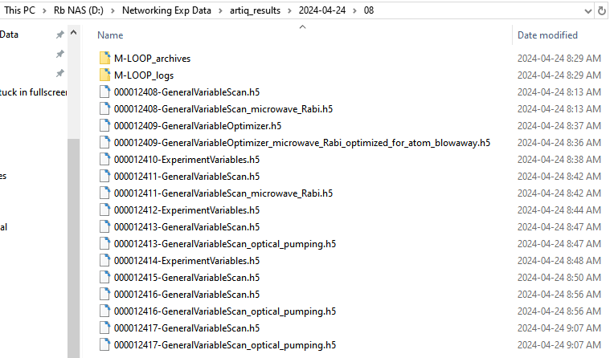
Data analysis
Saved files
ARTIQ saves datasets to an h5 file at the end of an experiment (i.e. when run() finishes or stops abruptly by raising an error). A directory with the date and subdirectory with the hour are automatically generated, and the experiment file will have the name of the experiment class in your file, e.g. GeneralVariableScan.
GeneralVariableScan and GeneralVariableOptimizer automatically save redundant h5 files with more useful names
The benefit of saving your experiment as a an ARTIQ dataset (as opposed to writing to a csv, etc) is that it will be automatically saved along with all of the ExperimentVariables (that’s right– each of these saves all of the ARTIQ datasets), so you have in a sense a “fingerprint” of your experiment.

Slide 45
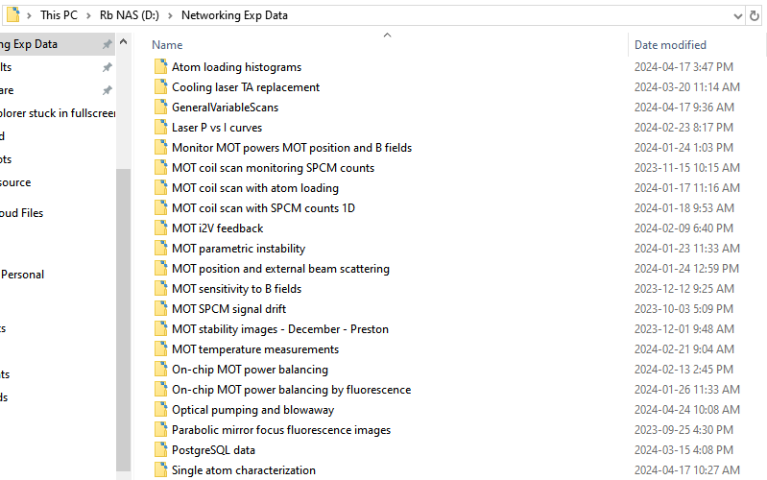
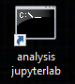
Data analysis
Jupyter notebooks
Jupyter notebooks with utility functions for streamlining h5 data analysis are on the networking PC. Those notebooks are in the directories shown.
Launch jupyterlab in the virtual environment

Slide 46
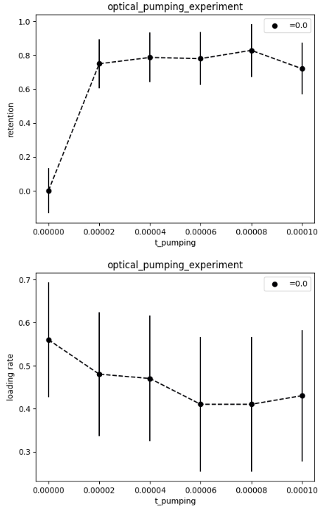
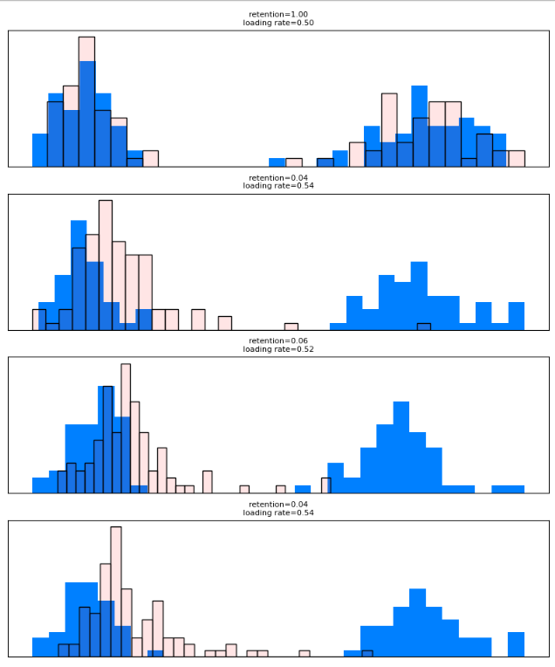
Data analysis
GeneralVariableScan analysis
The notebooks are particularly useful if you are analyzing data from a GeneralVariableScan, as the plots will be automatically labeled with the scan variables and experiment_function information. Loading and retention curves, as well as histograms can be generated.

Slide 47
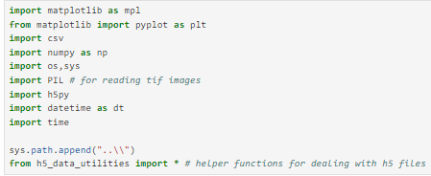

Data analysis
H5 data tools
The next couple of slides show the key utilities I use to analyze data in jupyterlab.
^The magic lives here
Search for experiment results by name and date

Slide 48

Data analysis
H5 data tools
The most important line.
This adds all of the data fields from ‘archive’ and ‘datasets’ in the h5 file to the local_variables in the notebook. This means that, for example, if there is a variable “f_cooling_DP_MOT” in your ExperimentVariables, there is now a variable defined with that name in your notebook. Like magic! ;)
That is how the code right after that line knows about experiment_function, t_FORT_drop, scan_sequence1, etc, even though we never explicitly defined them in this notebook.

Slide 49
Data analysis
H5 data tools
The most important line.
This adds all of the data fields from ‘archive’ and ‘datasets’ in the h5 file to the local_variables in the notebook. This means that, for example, if there is a variable “f_cooling_DP_MOT” in your ExperimentVariables, there is now a variable defined with that name in your notebook. Like magic! ;)
That is how the code right after that line knows about experiment_function, t_FORT_drop, scan_sequence1, etc, even though we never explicitly defined them in this notebook.

